Slide 1
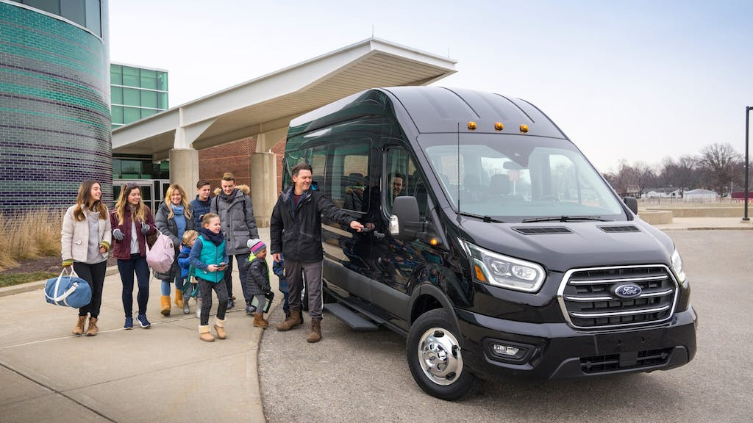
UBER-HCV OPERATIONAL CASE STUDY
By- Abhisek Dash

Slide 2

Agenda
Introduction of presenter
What I can bring to the team
Insights of analytics and Business acumen
TpR between subscription and non-subscription riders.
Initiatives recommend to grow overall average trips per rider (TpR) and to decrease cancellations of ride.
The completion rate (% of trips that got completed) and the cancellation rates by rider and by driver.
Distribution of fulfillment rate by hour of day and by day of week.
Other insights like avg. trip distance by driver, payment terms , no. of vehicle’s capacity & requests acc. distance
Analyze: For this analysis all vehicles with less than 14 seats are excluded.

Slide 3
Abhisek Dash
With over 4 years of experience in diverse industries, I bring a proven track record of driving impactful performance.
My background spans business, technology, and consumer services. I hold advanced qualifications in Business & Data Analysis. In my previous roles, I spearheaded revenue growth of 25% through data-driven insights and leveraging strategic skills.
I streamlined processes, reducing operational costs by 15% while maintaining quality. My leadership contributed to a 30% improvement in team efficiency.
What I can Bring to the Team:
Efficiency: I can handle large volumes of information and data quickly and accurately.
Versatility: I adapt to various tasks and industries, making me a valuable asset for the team's diverse needs.
Productivity: I assist in problem solving, enhancing business’s development and providing data-driven insights.
Scalability: I can support the team's growth and productivity by handling tasks which has been assigned.

Slide 4
Analytics and business acumen Tools used- Excel, Tableau & SQL
To conduct an in-depth analysis of the past performance of Heavy Commercial Vehicles (HCV) using the provided data, have gathered various insights and identify potential challenges and opportunities. Here are some possible analyses and recommendations based on the dataset:
Efficiency Improvements
Trip Completion and Cancellation Rates
Mode of payment Analysis
Driver Performance Metrics
Strategic solutions
Source Device-9996
iPhone-2858
Anroid-2867
Clienite-3982
Some Insight about the dataset which is extracted for easy understanding of it-
Total no. of Vehicles: 8368
Total requested trip: 9996
Time frame of data is February 2021
Average trip distance: 13 miles
Average pickup walk distance : 410 m

Slide 5
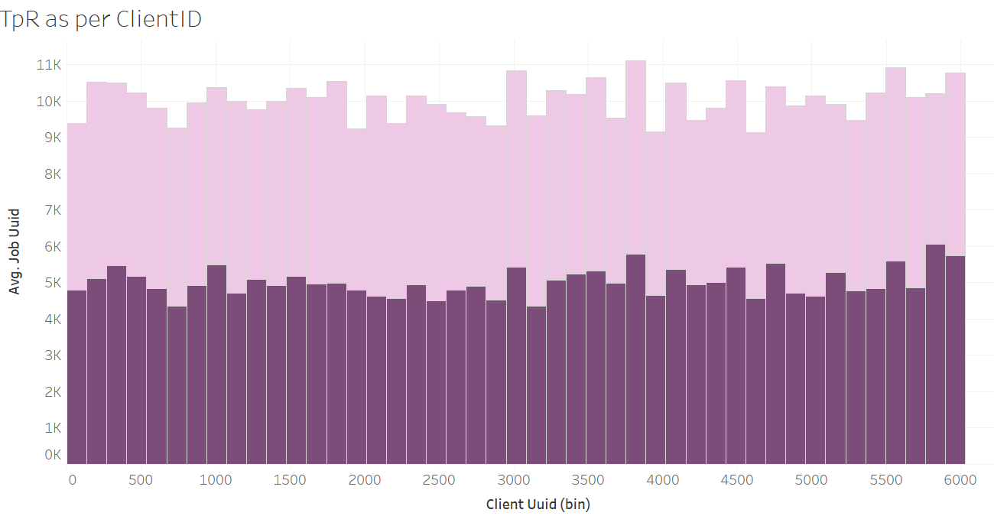
Average TpR between subscription and non-subscription riders
Non Subscriber
Subscriber

Slide 6
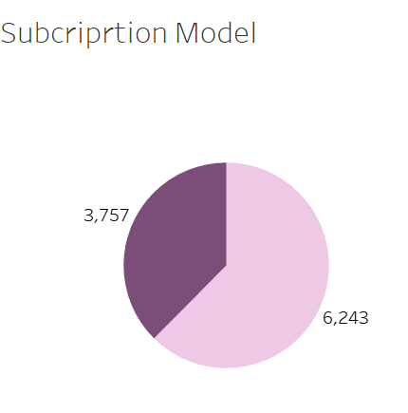
Initiatives recommend to grow overall average trips per rider (TpR) and to decrease cancellations of ride -
Loyalty and Rewards Programs
Rewarding frequent riders with discounts, free rides, or other incentives. Encourage riders to use the platform consistently to earn rewards.
Subscription Services
For subscription plan riders, allowing them to pay a monthly fee for a set number of rides.
Carpool and Shared Rides for commuters
Encourage the use of shared rides and carpooling to reduce costs and option for getting to and from work.
Corporate Partnerships
Establish partnerships with businesses to provide corporate ride programs, makes easier for employees to use Uber for work-related trips.
Environmental Initiatives
Promote environmentally friendly travel options, such as electric vehicles.
Quality Assurance
Ensure the quality of rides by monitoring driver behavior and addressing issues promptly. High-quality service encourages riders to return.
True
False

Slide 7
i.) Completed trip rate – no. completed trip/ total no. of trips * 100 - 6585/9945 * 100 = 66 % ii.) Rider canceled rate – no. rider canceled trip / total no. of trip * 100 - 2697/9945 * 100 = 27 .4 % iii.) Driver canceled rate – no. driver canceled trip / total no. of trip * 100 - 665 / 9945 = 6.6 %
The completion rate (% of trips that got completed) and the cancellation rates by rider and by driver.
Completed trip - 6585
Driver canceled -665
Rider canceled - 2697

Slide 8
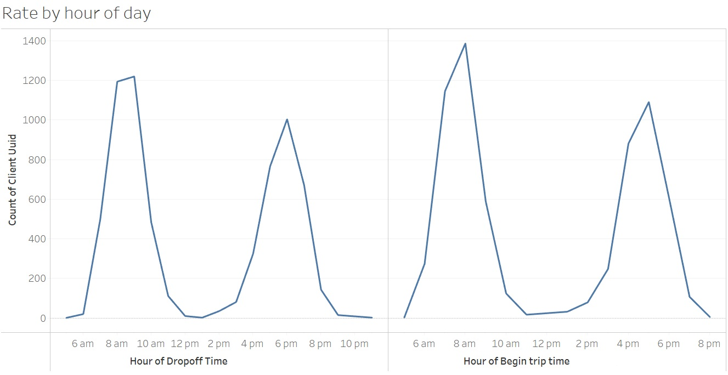
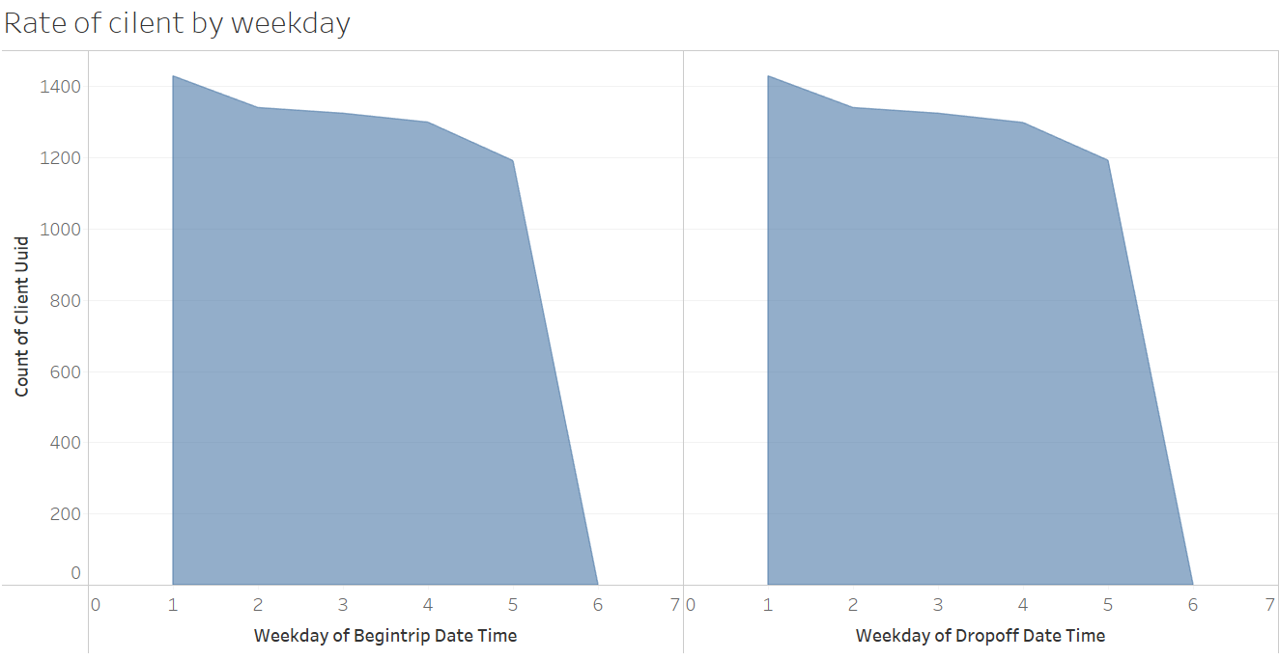
Distribution of fulfillment rate by hour of day and by day of week
Morning and evening time for booking rush is higher due office commuters.
Time frame between 6 – 10 A.M in morning and 4 – 10 PM in evening .
Traffic of rider on Sunday is higher side due to availability of time.
On weekdays the office commuter maintain the rider base.

Slide 9
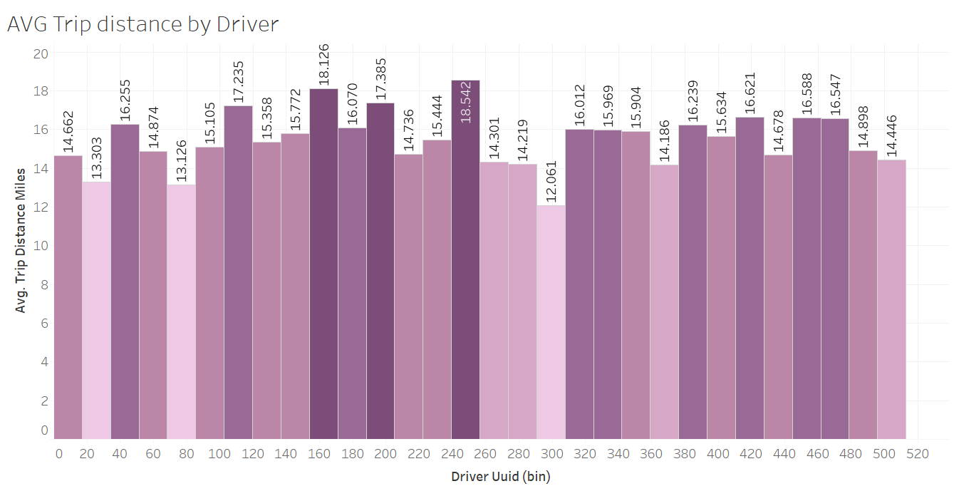
Top 10 Trip distance : 50-56 miles ( 85 % of the request were PRESCHECLUDE)
Avg. Trip distance by driver : 13 miles
Outliner – 85 miles

Slide 10
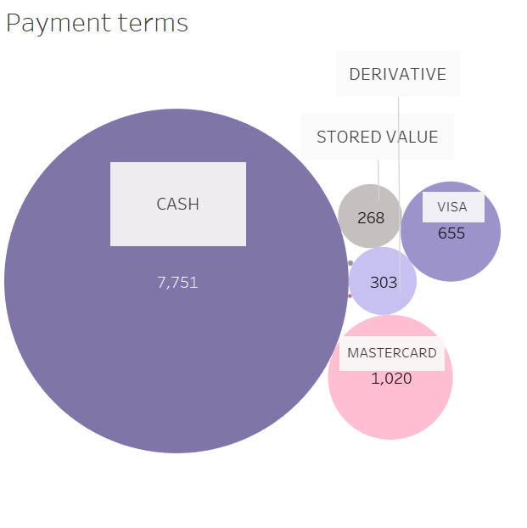
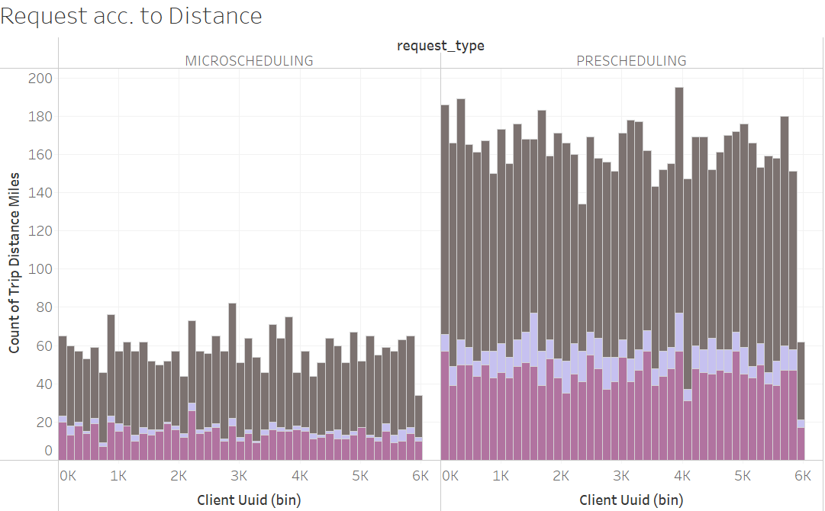
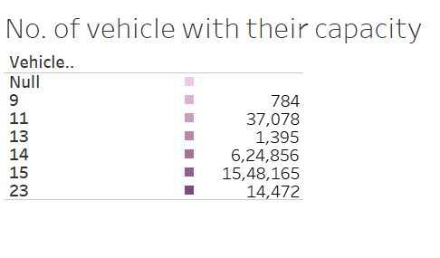
Photo Collage

Slide 11
THANK YOU

